Slide 1


Drone-Based Mapping System
Understanding Multi-View Geometry, Binocular Vision, and Image Formation
Presented by Gadwal Mohammad Muzammil
Register Number 192424279
Department AI & DS
Supervised by Mayuranathan M

Slide 2











Introduction to Drone Mapping
Overview
Technical Foundation
What is Drone-Based Mapping?
Key Technologies
Uses specialized drones equipped with advanced optical cameras to capture highly accurate aerial imagery, which is mathematically resolved into photorealistic 3D models.
Multi-View Geometry
Recovering complete 3D environmental architecture from overlapping 2D imagery.
Binocular Vision
Extracting absolute spatial depth using stereo shifts or consecutive flight capture pairings.
Image Formation
Managing raw light physics passing through lenses to generate high-fidelity sensor matrices.

Slide 3
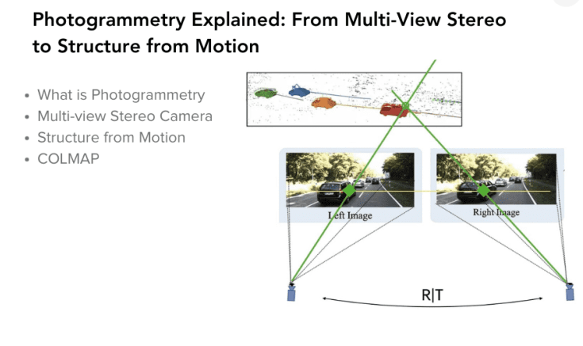


Multi-View Geometry Principles
MATHEMATICAL STRUCTURE
Recovering 3D scene geometry
Multi-view geometry studies how 3D structural details can be calculated back by linking light pathways from several images taken from distinct camera coordinates.
Successive Captures
Drones capture a grid of consecutive, high-overlap images over the target site.
Keypoint Matching
Computer vision locks identical feature descriptors across frames to estimate camera path orientation.

Slide 4


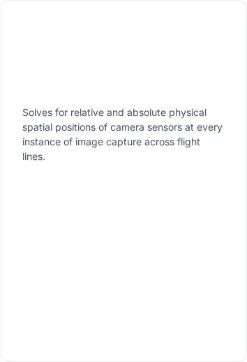


Multi-View Geometry Applications
3D Terrain Modelling
No Laser Requirements
Path Trajectory Calculation

Slide 5

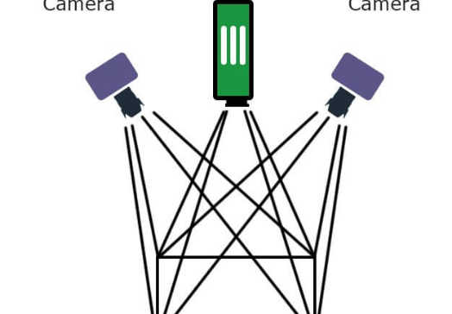
Principles of Binocular Vision
BIOMIMETIC SENSING
Simulating biological depth depth
Binocular vision replicates human vision. By processing visual info from two separate horizontal apertures, we extract spatial depth coordinates relative to the lenses.
Relative Baseline Displacement
Captures perspectives separated by a small, calibrated physical distance.
Virtual Stereo Combinations
Achieved through dedicated dual-lens rigs or by combining high-overlap sequential single-lens frames along paths.

Slide 6
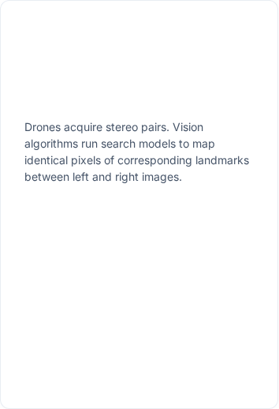
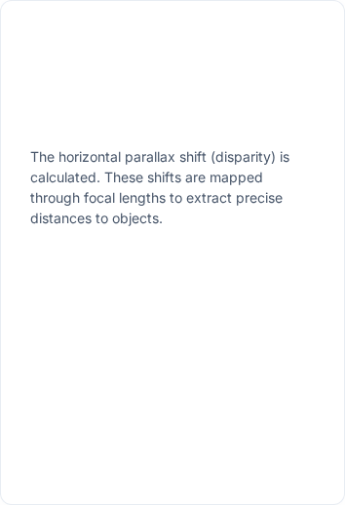
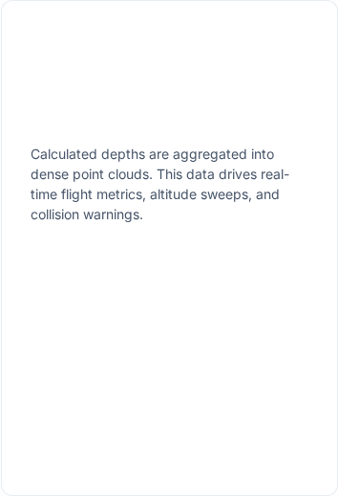
Depth Processing Pipeline
1. Feature Matching
2. Disparity Mapping
3. Cloud Compilation

Slide 7
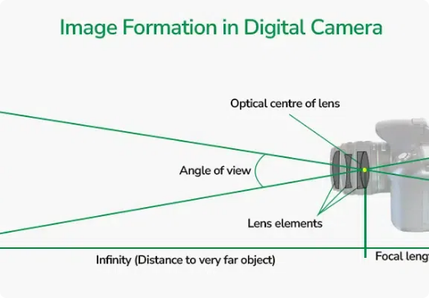

Physics of Image Formation
OPTICAL PROJECTION
Resolving real world into digital
Image formation defines the mathematical transition of light waves reflected from physical targets through custom focal lenses and onto digital sensor grids.
Reflected Light
Optical Lenses
Sensor Capture
Digital Data

Slide 8
Factors and Impact on Mapping
Hardware & Environmental
Pipeline Impact
Optical Distortions & Quality
Downstream Reconstruction Quality
Reconstruction precision depends heavily on raw image accuracy. Major factors affecting spatial data cleanups include:
Optimal optical capture establishes pristine raw pixel inputs, leading to drastic downstream improvements:
Solid Keypoint Tracking
System Setup
High-contrast, clean-focus textures allow computers to easily match homologous locations.
Lenses sharpness, high sensor resolution, precise aperture settings, and camera calibration.
Minimized Processing Errors
Environmental Exposure
Eliminates geometric warping artifacts in final structural outputs.
Flight elevations, atmospheric haze, crosswinds shaking the drone, and poor site lighting.

Slide 9




End-to-End Mapping Workflow
01. CAPTURE
03. COMPUTE
Grid Path Planning
Geometry & Disparity
UAV plans grid trajectories and begins autonomous sweeps to capture high-overlap frames.
Core models track descriptors, execute camera position checks, and compile stereo baseline ranges.
02. OPTICS
04. OUTPUT
Optical Formation
Spatial Map Models
Camera focal lenses focus reflected light rays onto digital sensors to produce pristine raw images.
Point clouds output highly accurate structural meshes, digital elevation maps, and final GIS layers.

Slide 10

Future of Drone Mapping
By dynamically chaining Image Formation (lens calibrations), Binocular Vision (depth metrics), and Multi-View Geometry (structural parameters), modern aerial drones turn raw flat snapshots into highly-accurate digital replicas of our complex planet.
Questions & Discussion
Thank you for your valuable time and attention.
SURVEYING • AGRICULTURE • CONSTRUCTION • GEOSPATIAL INSIGHTS

